Slide 1



DATABASE COFFESHOP
Kelompok 11

Slide 2




members of the group
Namira Assalwa
Muhamad Rifqi Alfareza
Zulfarida

Slide 3


Background
An integrated data management system is crucial for cafe business success. Effective data management enhances order accuracy, optimizes inventory, monitors operational performance and generates accurate financial reports, ultimately impacting service quality, customer satisfaction and sustainable business growth.

Slide 4

Database Definition
A cafe database is a structured collection of data managing operational information, including menus, inventory, customer details, orders, employee schedules, financial transactions and suppliers.
Its purpose is to enhance operational efficiency, accelerate decision-making and simplify data management.

Slide 5


Database Design
Database Name : cafe_management_db
Number of table : 10
  Profile Cafe Table
  Cabang Cafe
  Menus Table
  Status Menu Cabang Table
  Customers Table
  Transactions Table Details Transaction Table

Slide 6



  Suppliers Table
  Reservations Table
  Tables Table
Number of Views : 5
  vw_menu_per_cabang
  vw_customer_orders
  vw_stock_per_menu
  vw_daily_sales
  vw_top_customers
Number of Procedure : 3
  proc_AddNewTransaction
  proc_AddStockToCabang
  proc_UpdateMenuPrice

Slide 7
Number of Triggers : 4
  Trg_UpdateStockAfterOrder
  Trg_PreventNegativeStock
  Trg_CascadeDeleteCabang
  Trg_RestoreStockOnOrderCancel
Number of Indexes : 2
  idx_fulltext_menus_name_description
  idx_fulltext_customers_name_contact

Slide 8

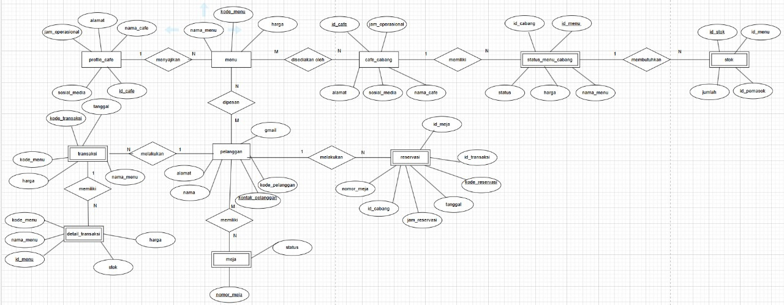

ENTITY RELATIONSHIP DIAGRAM

Slide 9
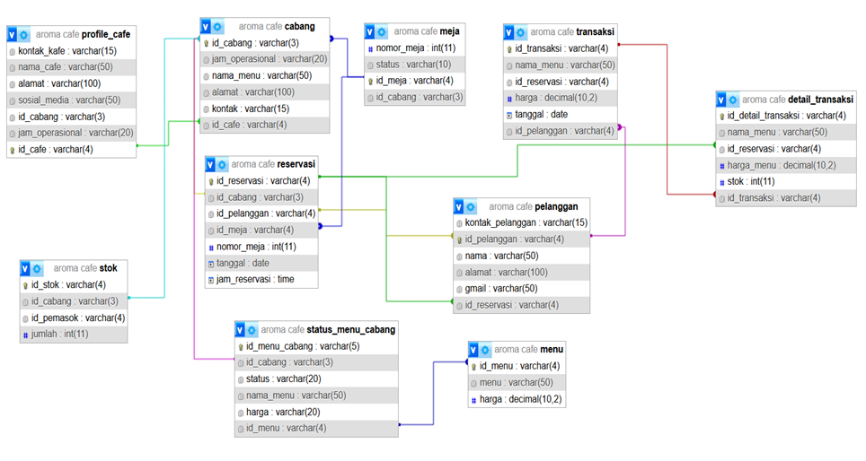
SCHEMATIC PROGRAM

Slide 10


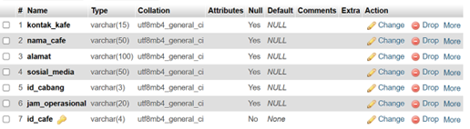
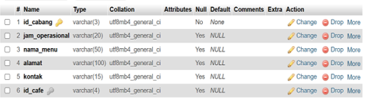
TABLE DESIGN
Profile Cafe Table
Cabang Cafe Table

Slide 11



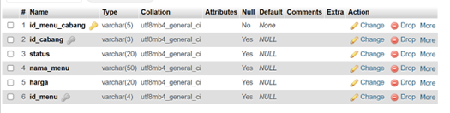
Menus Table
Status Menu Cabang Table

Slide 12

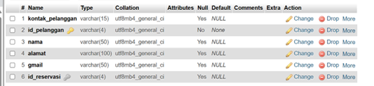

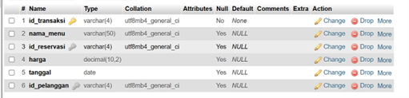
Customers Table
Transactions Table

Slide 13


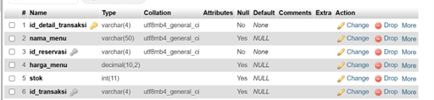

Details Transaction Table
Suppliers Table

Slide 14
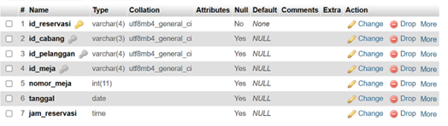
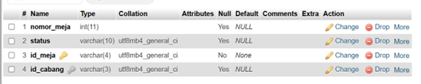
Reservations Table
Tables Table

Slide 15
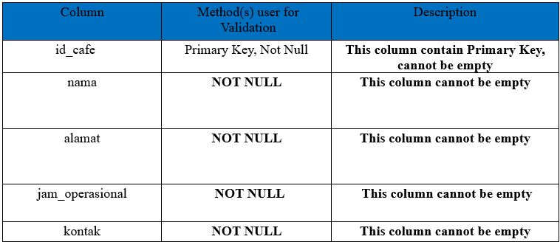
VALIDATION PERFORM
CAFE TABLE

Slide 16
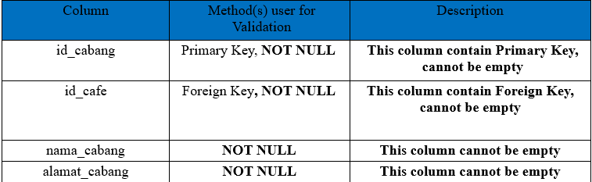
CABANG TABLE

Slide 17
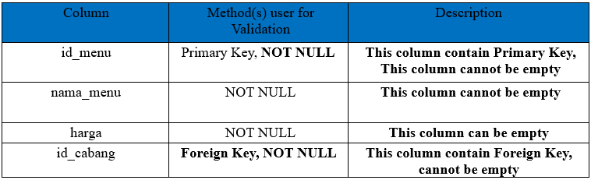
MENU TABLE

Slide 18
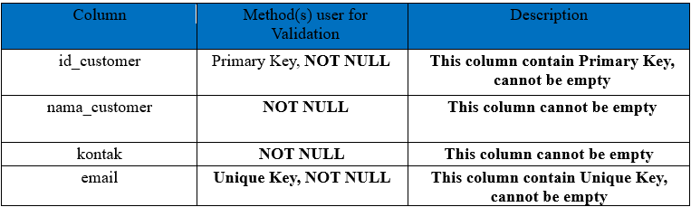
CUSTOMERS TABLE

Slide 19
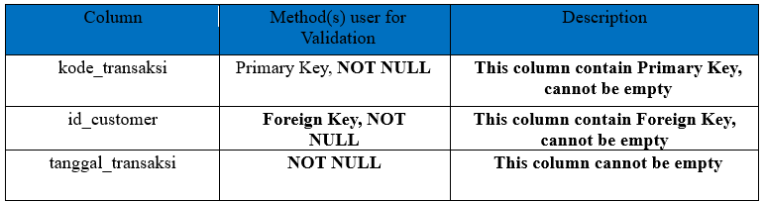
TRANSACTIONS TABLE

Slide 20
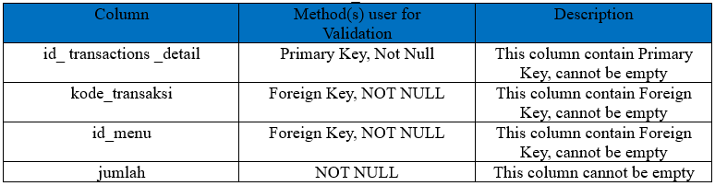
TRANSACTIONS DETAILS TABLE

Slide 21
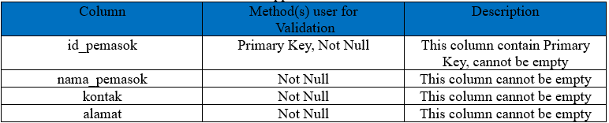
SUPPLIERS TABLE

Slide 22
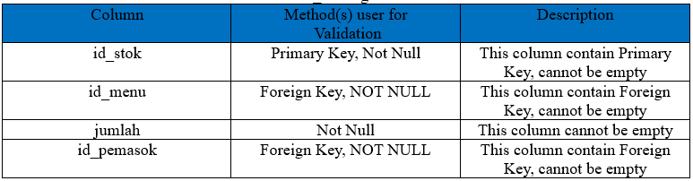
STOK BARANG TABLE

Slide 23
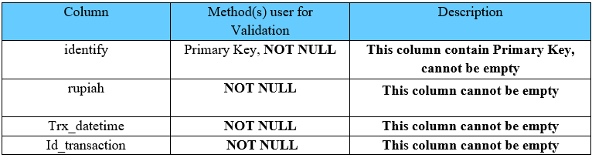
CUSTOMERS TABLE

Slide 24
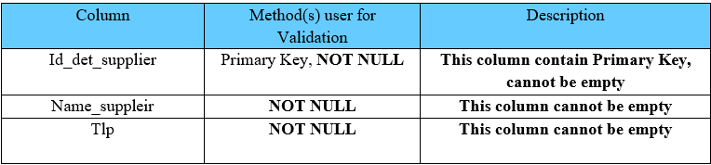
DETAIL SUPPLIER TABLE

Slide 25
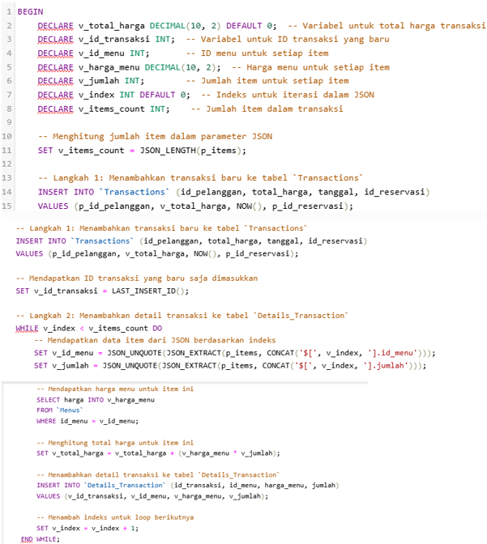
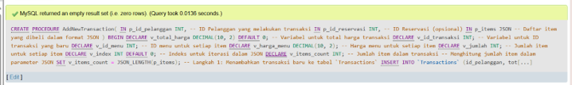
STORED PROCEDURE
Procedure AddNewTransaction

Slide 26
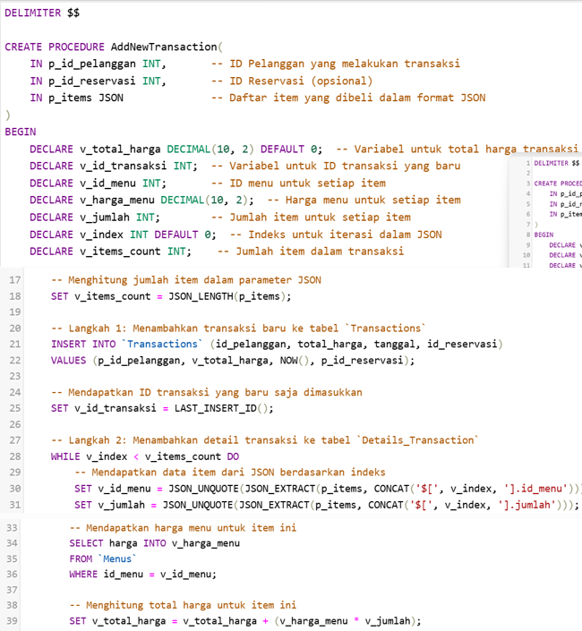
Procedure AddStockToCabang

Slide 27
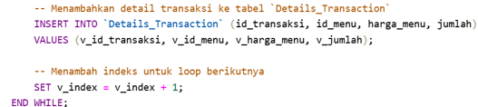


Slide 28
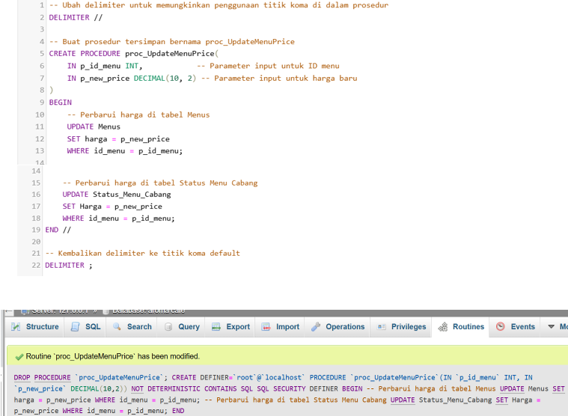
Procedure AddStockToCabang

Slide 29
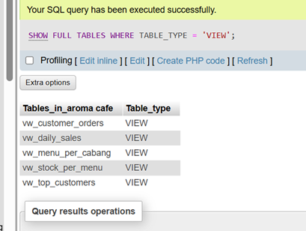
view

Slide 30
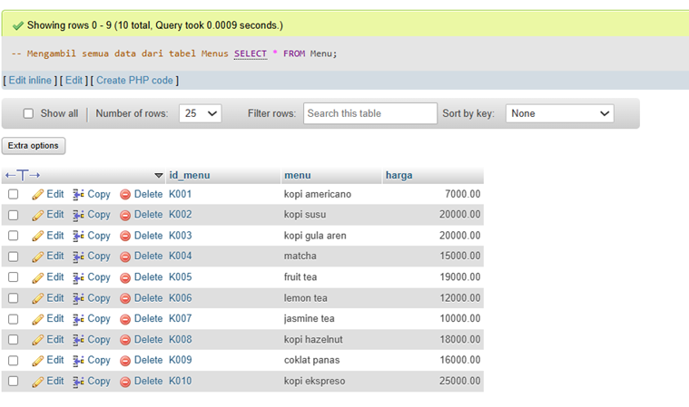
fulltext menu

Slide 31
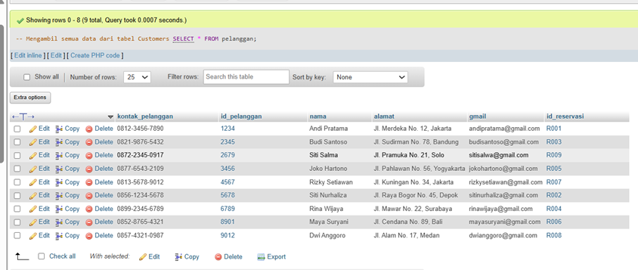
fulltext customer

Slide 32
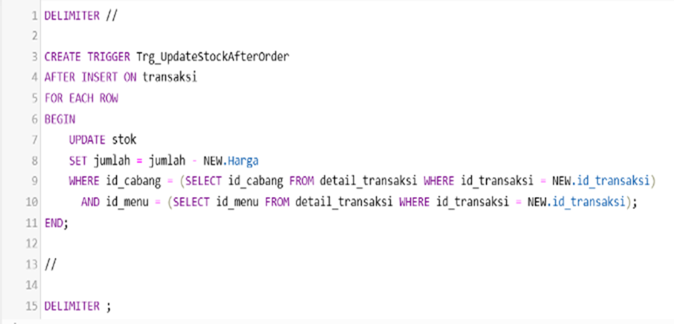
Trigger Update Stock After Order

Slide 33
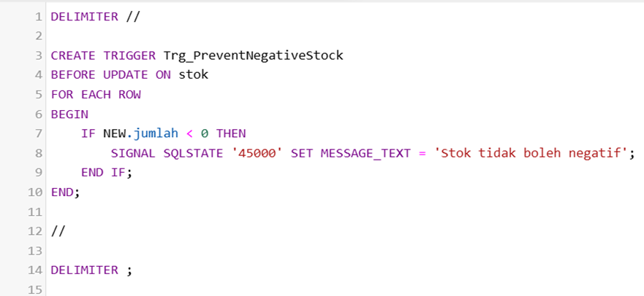
Trigger Prevent Negative Stoc

Slide 34
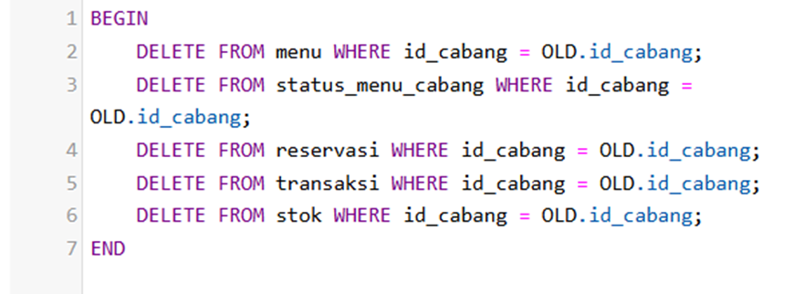
Trigger Cascade Delete Cabang

Slide 35
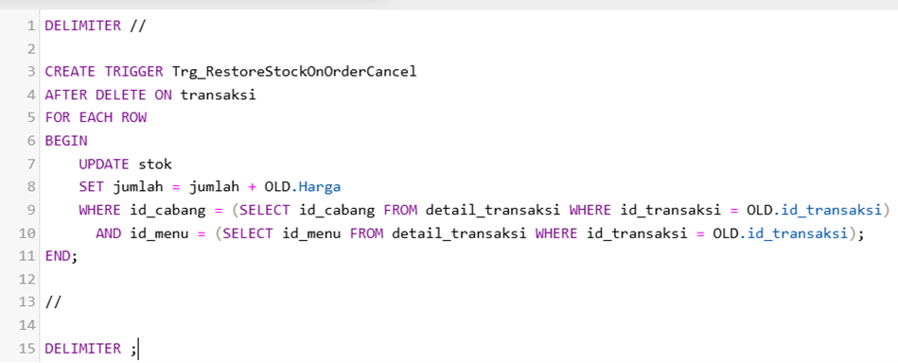
Trigger Restore Stock On Order Cancel

Slide 36
conclusion
A coffeeshop database is an organized data storage system to support operations and business decision making. By integrating customer, menu, inventory, transaction and financial data, this database enables more efficient management, improved customer experience, and provides accurate analytical reports to support more effective business strategies.

Slide 37
THANK YOU

